Slide 1

Module 3
Deep Learning: Feed-Forward Architectures
Notes:
Guidelines
Use section headers to chunk content in your presentation.
Use the same style of section header throughout your presentation.
Keep your title to no more than 2 lines.

Slide 2
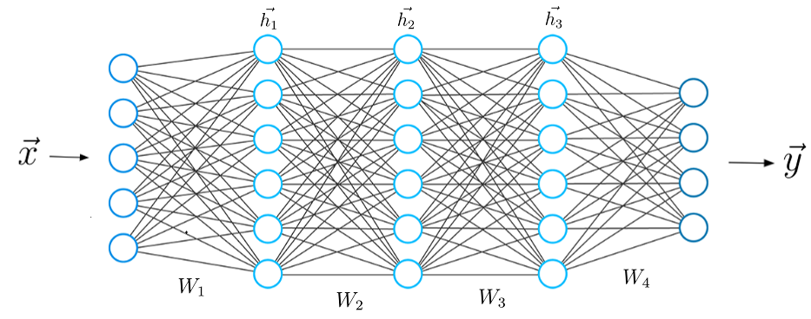
DL: Feed-Forward Architectures
Notes:
Guidelines
Use a title slide at the beginning of your presentation. There are 9 variations of title slides to choose from.
If you will have a series of slideshows, we recommend using the same style of title slide for each presentation.
Keep your title to no more than 2 lines.
Do not change the font style or font size of the title or subtitle.

Slide 3
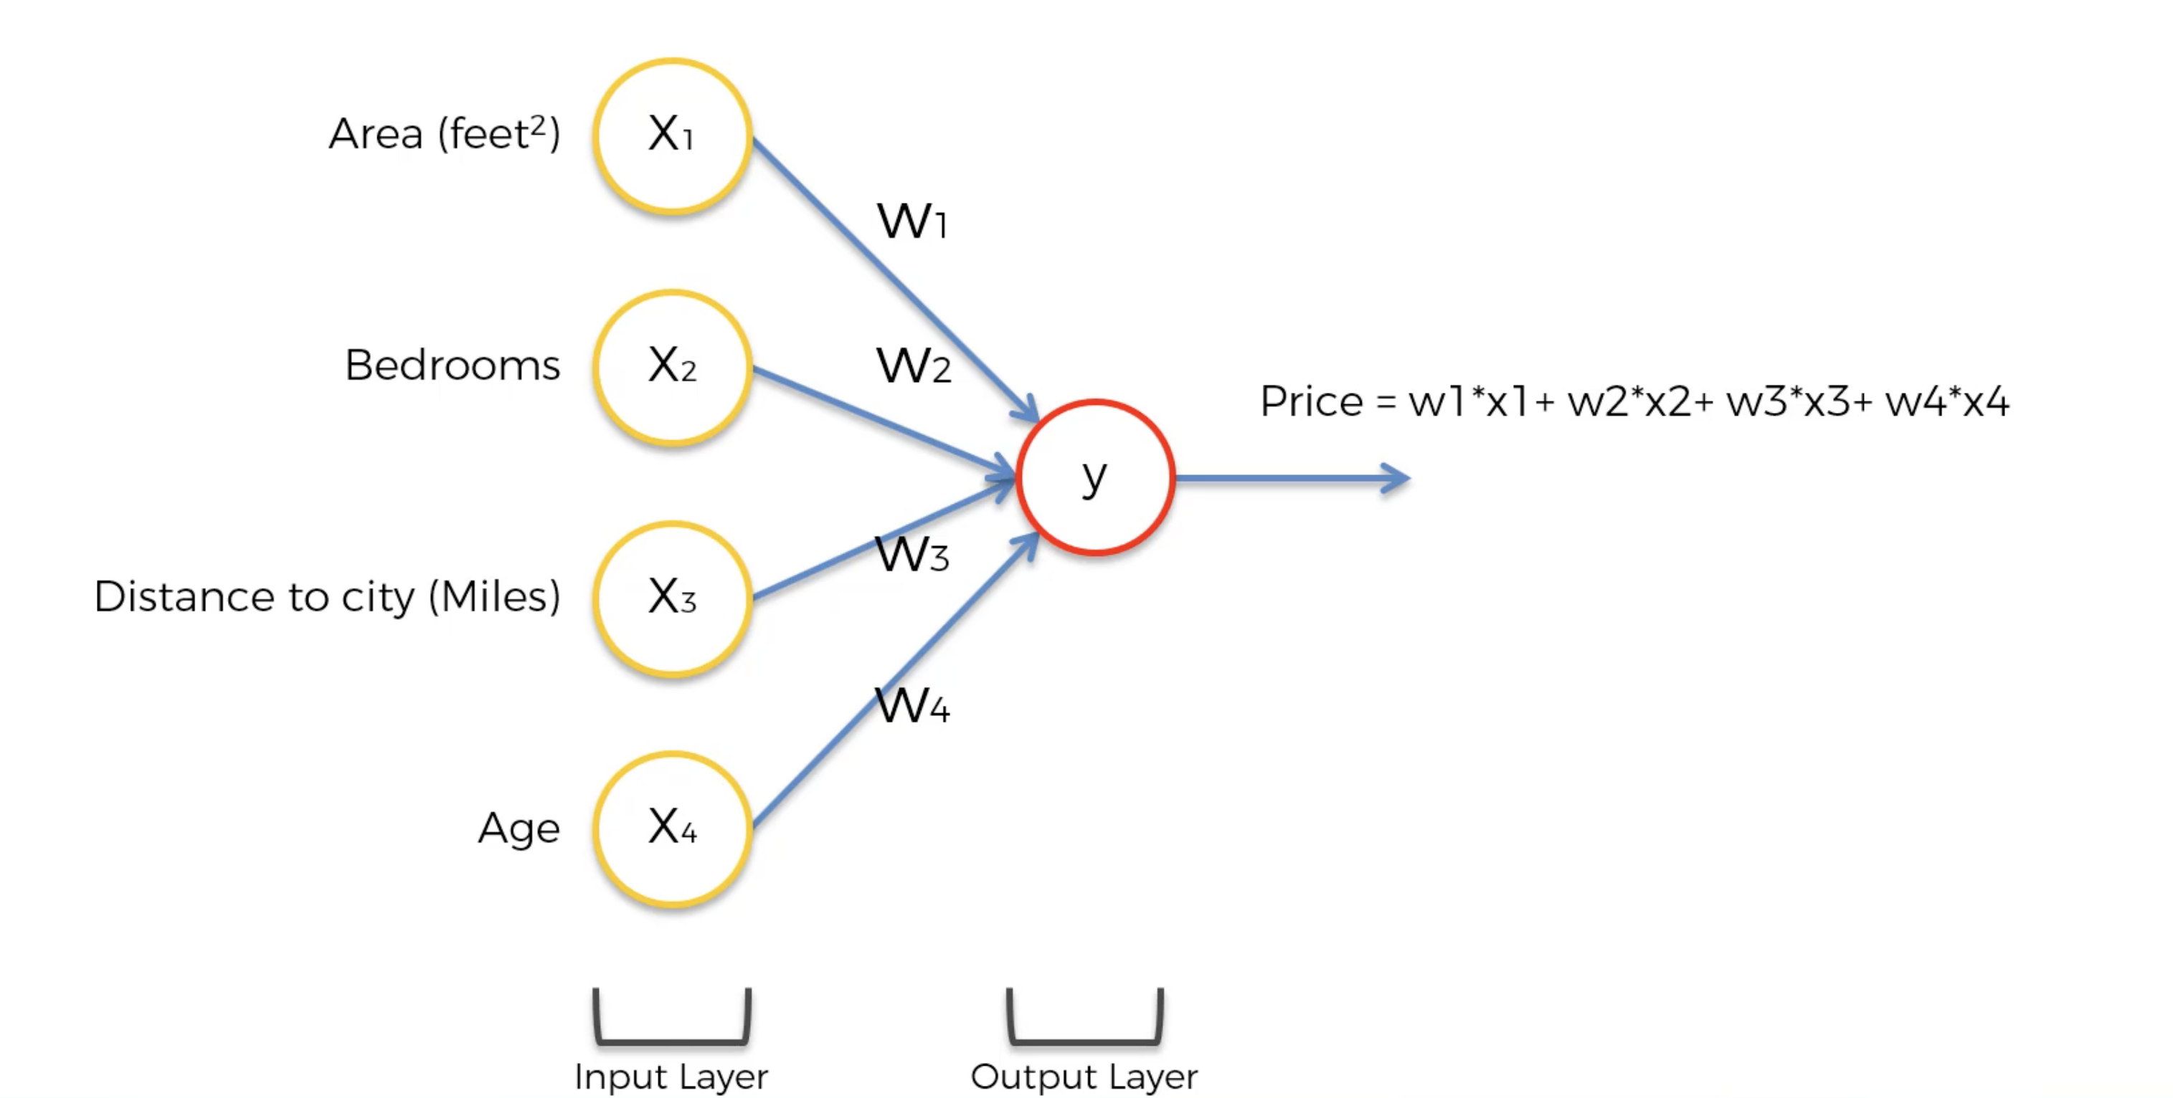
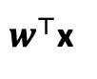
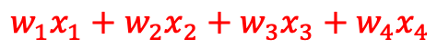
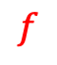

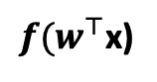
The Forward Pass
Input nodes ▻ hidden nodes ▻ output nodes
This is called the forward pass
$$∑$$
$$w_{1}x_{1}+w_{2}x_{2}+w_{3}x_{3}+w_{4}x_{4}$$
$w^{⊤}$x
$$f$$
${f(w}^{⊤}$x)

Slide 4
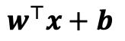
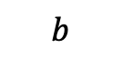
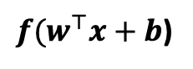
The Forward Pass
Input nodes ▻ hidden nodes ▻ output nodes
This is called the forward pass
1
$$∑$$
$${b+w}_{1}x_{1}+w_{2}x_{2}+w_{3}x_{3}+w_{4}x_{4}$$
$w^{⊤}x+b$
$$b$$
$$f$$
$f(w^{⊤}x+b$)

Slide 5
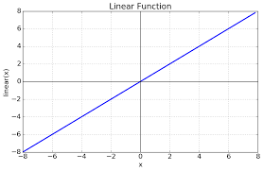
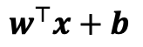
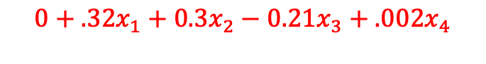
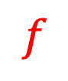
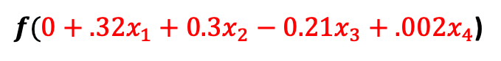
The Forward Pass
Input nodes ▻ hidden nodes ▻ output nodes
This is called the forward pass
1
$$∑$$
$$0+.32x_{1}+0.3x_{2}−0.21x_{3}+.002x_{4}$$
$w^{⊤}x+b$
$$b$$
$$f$$
$f(0+.32x_{1}+0.3x_{2}−0.21x_{3}+.002x_{4}$)
$$f$$

Slide 6
Python
Notes:
Guidelines
Use a title slide at the beginning of your presentation. There are 9 variations of title slides to choose from.
If you will have a series of slideshows, we recommend using the same style of title slide for each presentation.
Keep your title to no more than 2 lines.
Do not change the font style or font size of the title or subtitle.

Slide 7
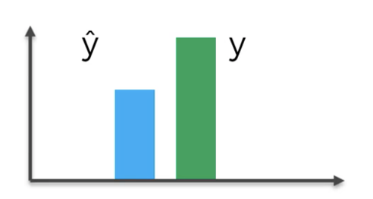
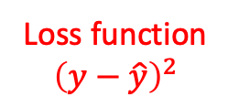
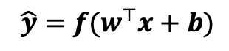
The Forward Pass
Input nodes ▻ hidden nodes ▻ output nodes
This is called the forward pass
1
$$b$$
$${ \hat{y}=f(w}^{⊤}x+b)$$
Loss function
$${\left(y−\hat{y}\right)}^{2}$$

Slide 8
The Forward Pass
Input nodes ▻ hidden nodes ▻ output nodes
This is called the forward pass
1
$$b$$
$${ \hat{y}=f(w}^{⊤}x+b)$$
Loss function
$${\left(y−\hat{y}\right)}^{2}$$

Slide 9
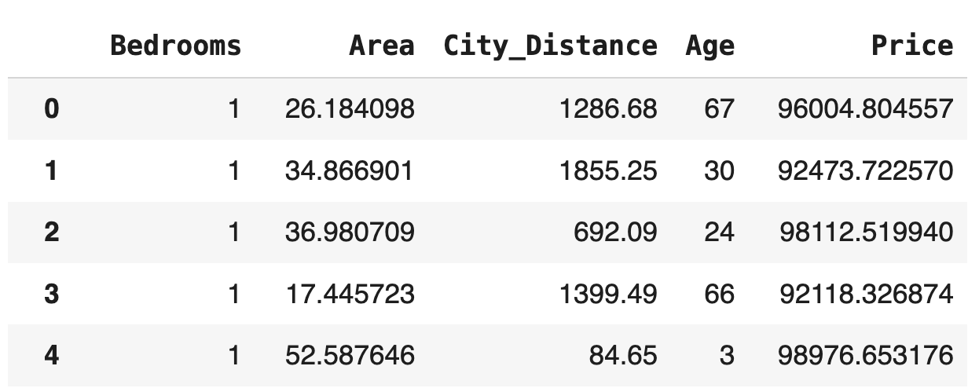
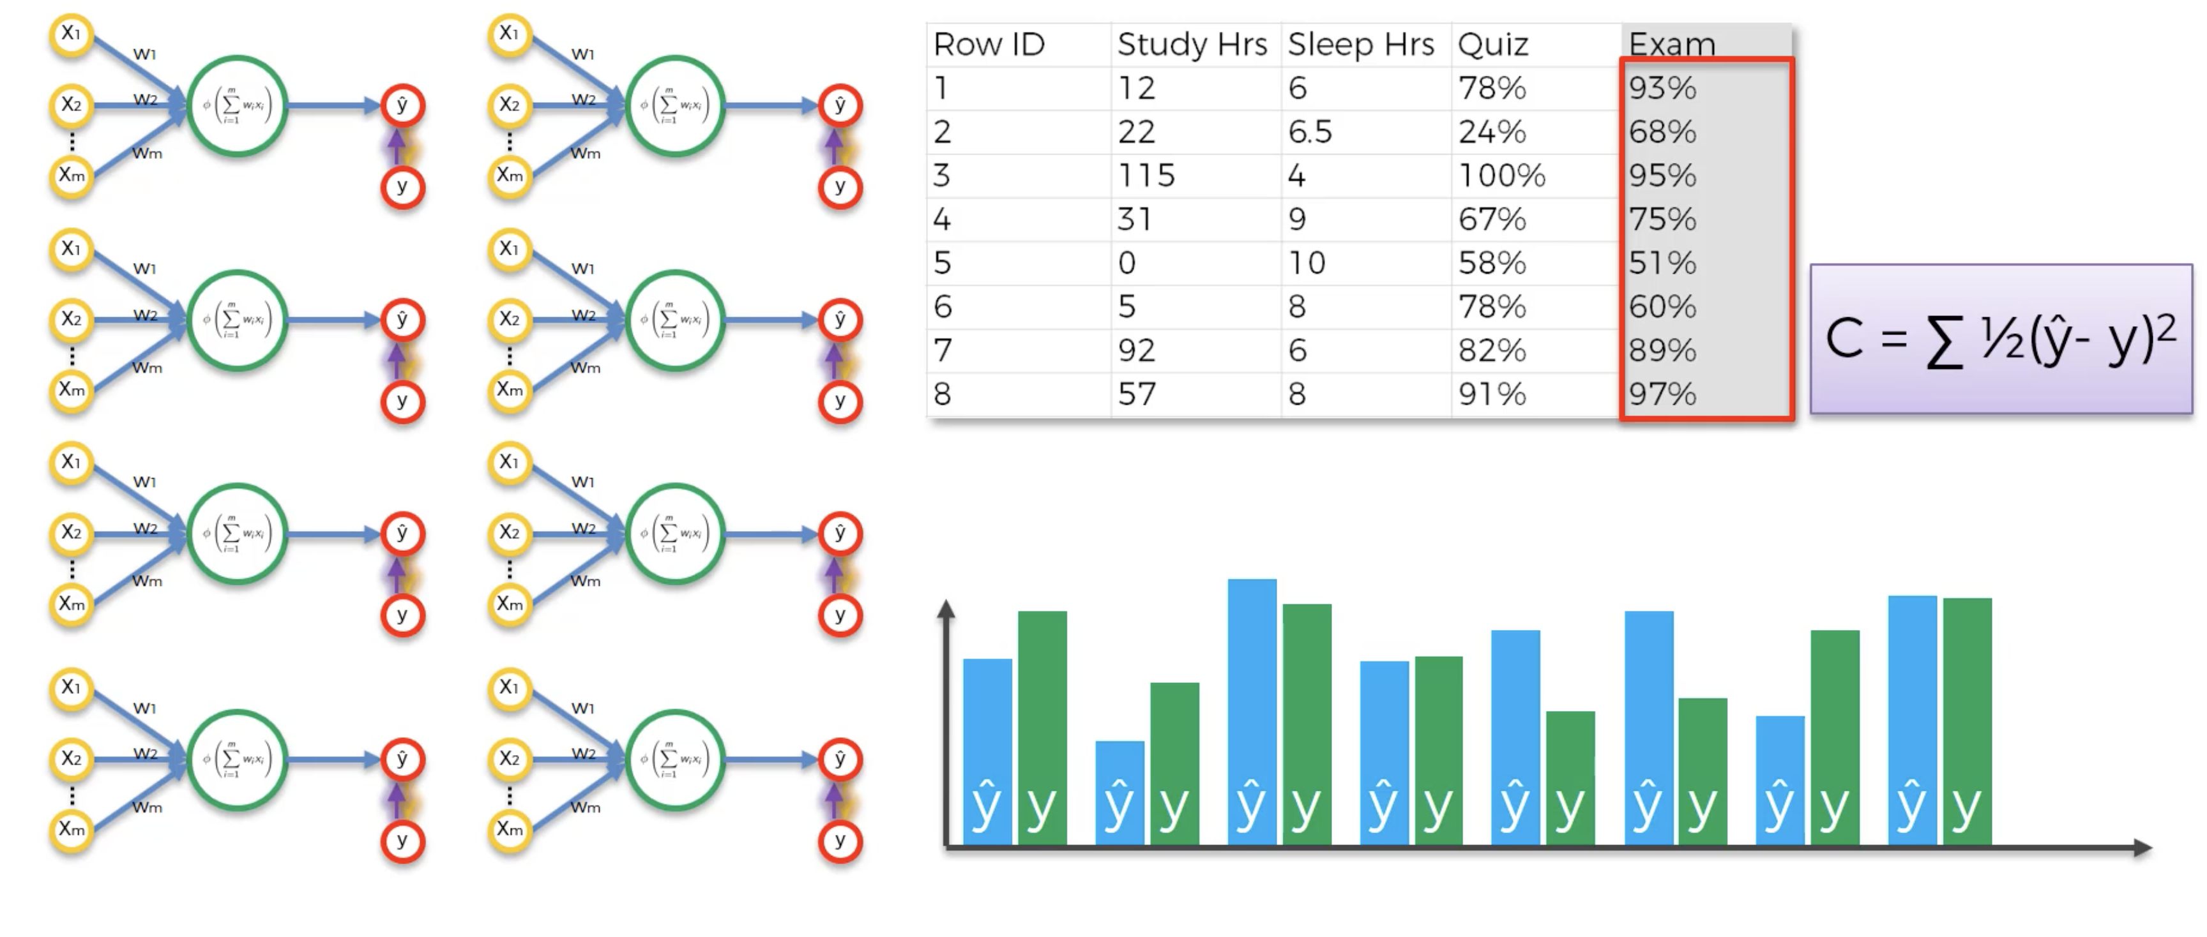
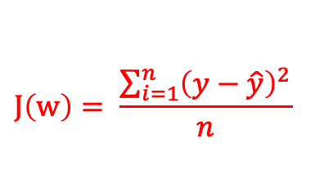
The Forward Pass
Input nodes ▻ hidden nodes ▻ output nodes
This is called the forward pass
$$J\left(w\right)= \frac{\sum_{i=1}^{n}{{\left(y−\hat{y}\right)}^{2}}}{n}$$

Slide 10
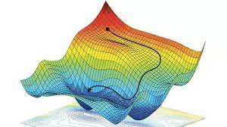
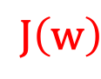
The Forward Pass
Input nodes ▻ hidden nodes ▻ output nodes
This is called the forward pass
$$J\left(w\right)$$
1
$$b$$
$${ \hat{y}=f(w}^{⊤}x+b)$$

Slide 11
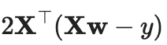
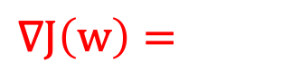
The Forward Pass
Input nodes ▻ hidden nodes ▻ output nodes
This is called the forward pass
$$∇J\left(w\right)=$$
1
$$b$$
$${ \hat{y}=f(w}^{⊤}x+b)$$

Slide 12
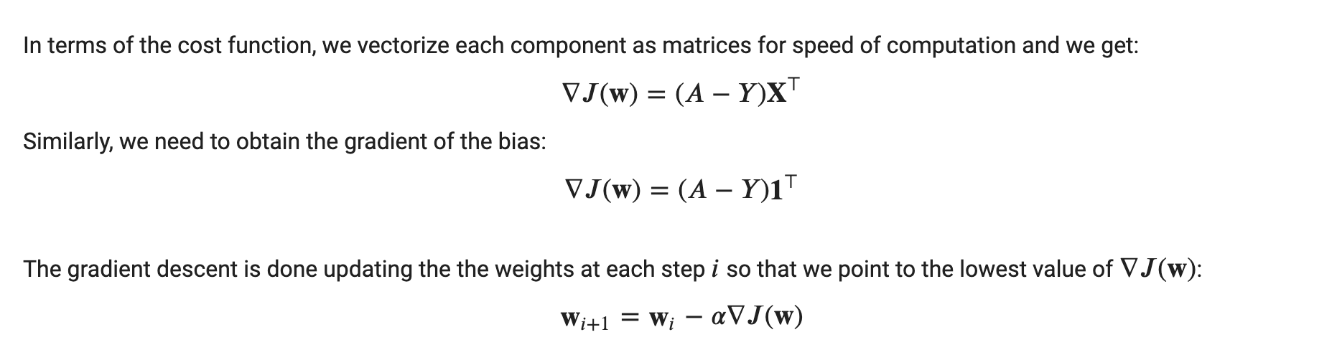
Backward Propagation
Output nodes ▻ hidden nodes ▻ input nodes
This is called the backward pass
1
$$b$$
$${ \hat{y}=f(w}^{⊤}x+b)$$

Slide 13

Forward Pass
Input nodes ▻ hidden nodes ▻ output nodes
This is called the forward pass
$$J\left(w\right)$$
1
$$b$$
$${ \hat{y}=f(w}^{⊤}x+b)$$

Slide 14
Backward Pass
Output nodes ▻ hidden nodes ▻ input nodes
This is called the backward pass
1
$$b$$
$${ \hat{y}=f(w}^{⊤}x+b)$$

Slide 15
Python
Notes:
Guidelines
Use a title slide at the beginning of your presentation. There are 9 variations of title slides to choose from.
If you will have a series of slideshows, we recommend using the same style of title slide for each presentation.
Keep your title to no more than 2 lines.
Do not change the font style or font size of the title or subtitle.

Slide 16
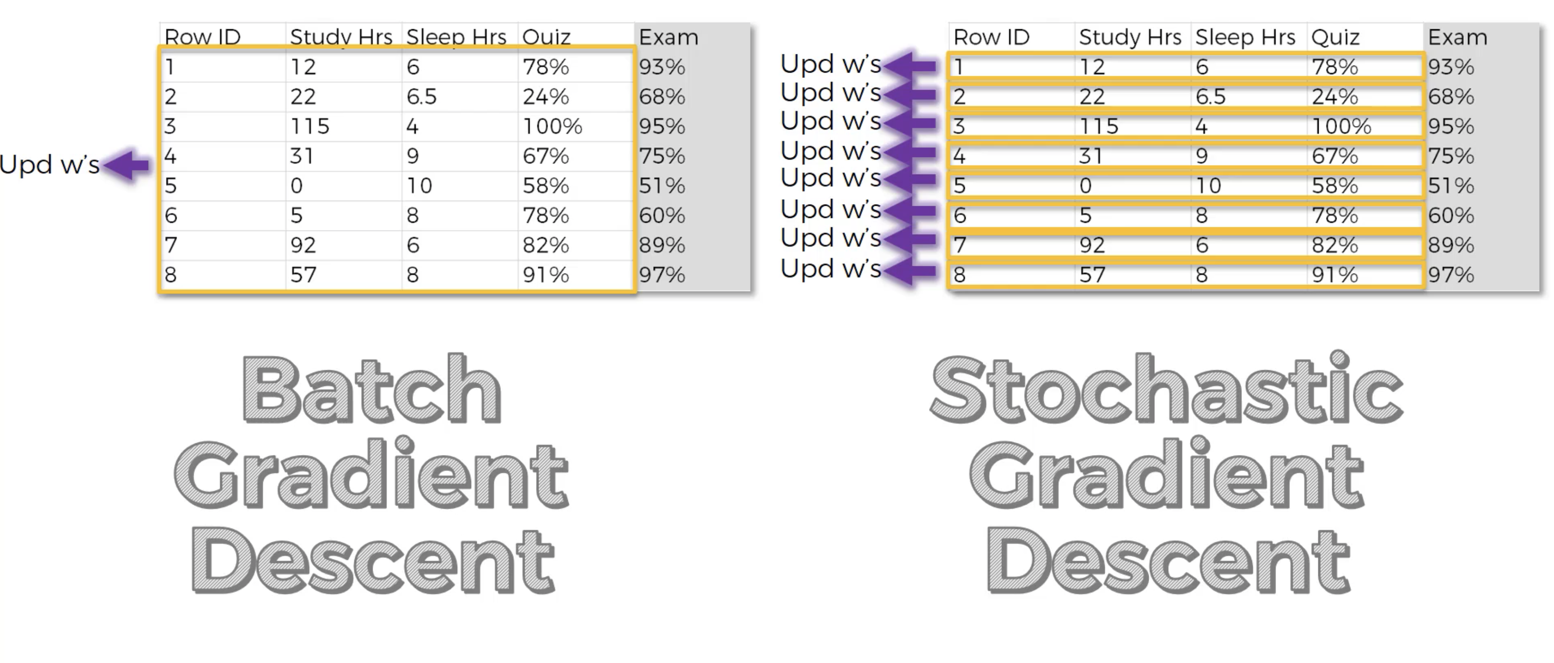
Batch Gradient Descent
We do not need to update the weights using ALL observations
A batch can do as well
We still need to go over ALL observations (epoch)

Slide 17
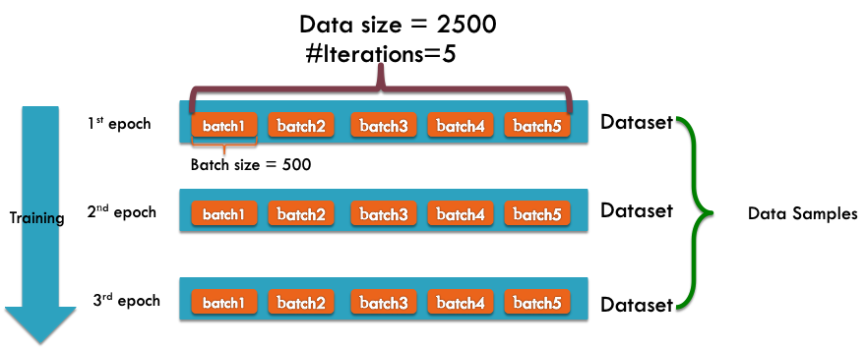
Batch Gradient Descent
We do not need to update the weights using ALL observations
A batch can do as well
We still need to go over ALL observations (epoch)

Slide 18
Python
Notes:
Guidelines
Use a title slide at the beginning of your presentation. There are 9 variations of title slides to choose from.
If you will have a series of slideshows, we recommend using the same style of title slide for each presentation.
Keep your title to no more than 2 lines.
Do not change the font style or font size of the title or subtitle.

Slide 19
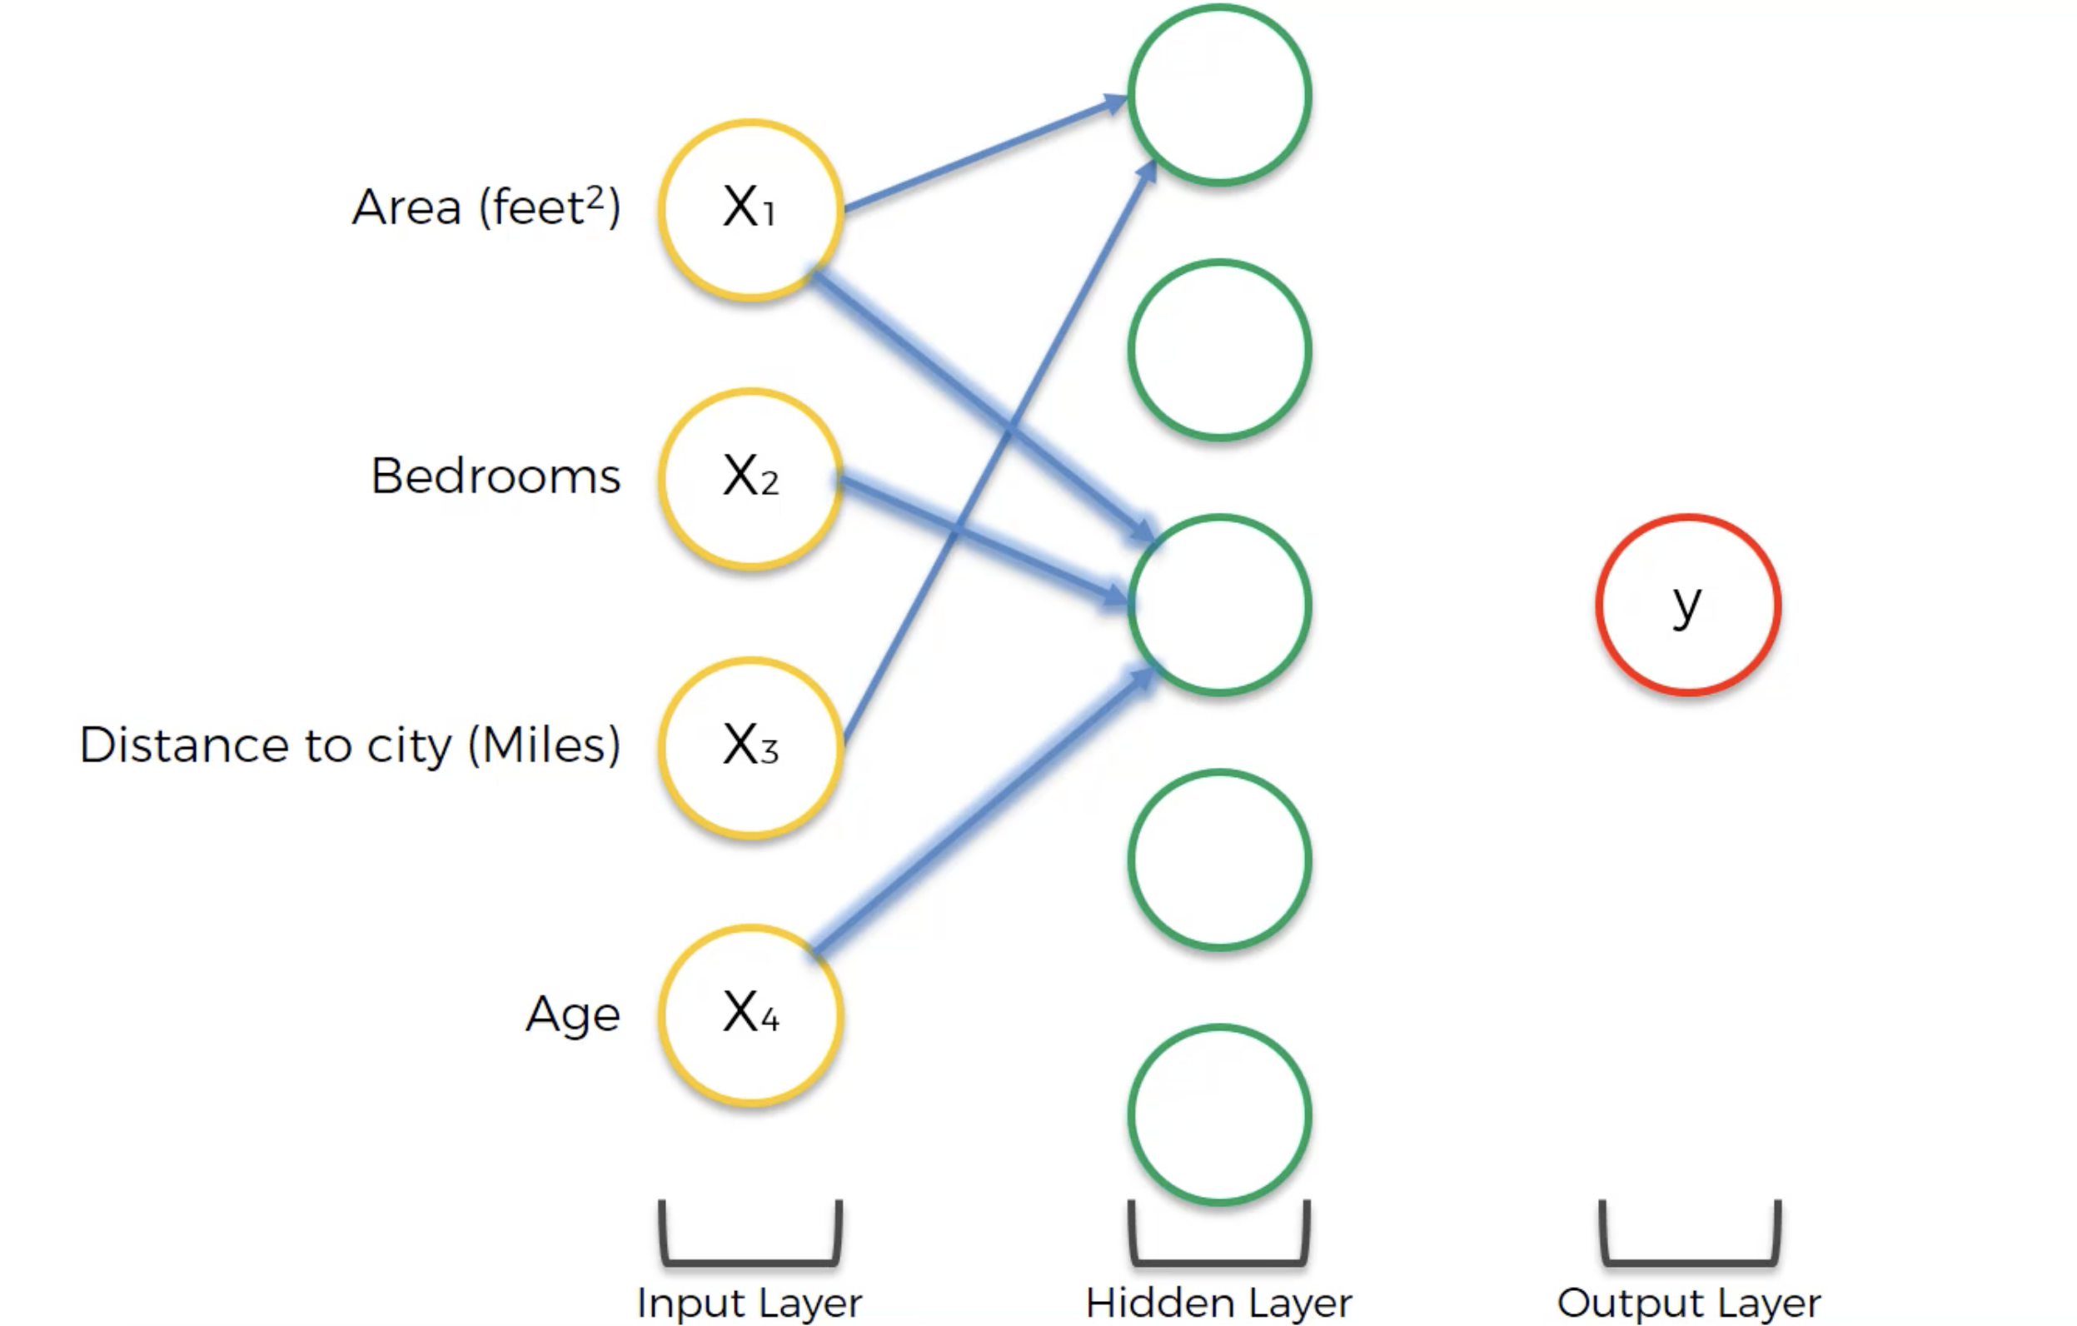
Forward Pass
Hidden layers measure higher-order interactions
$$J\left(w\right)$$
$$b$$
$${ \hat{y}=f(w}^{⊤}x+b)$$

Slide 20
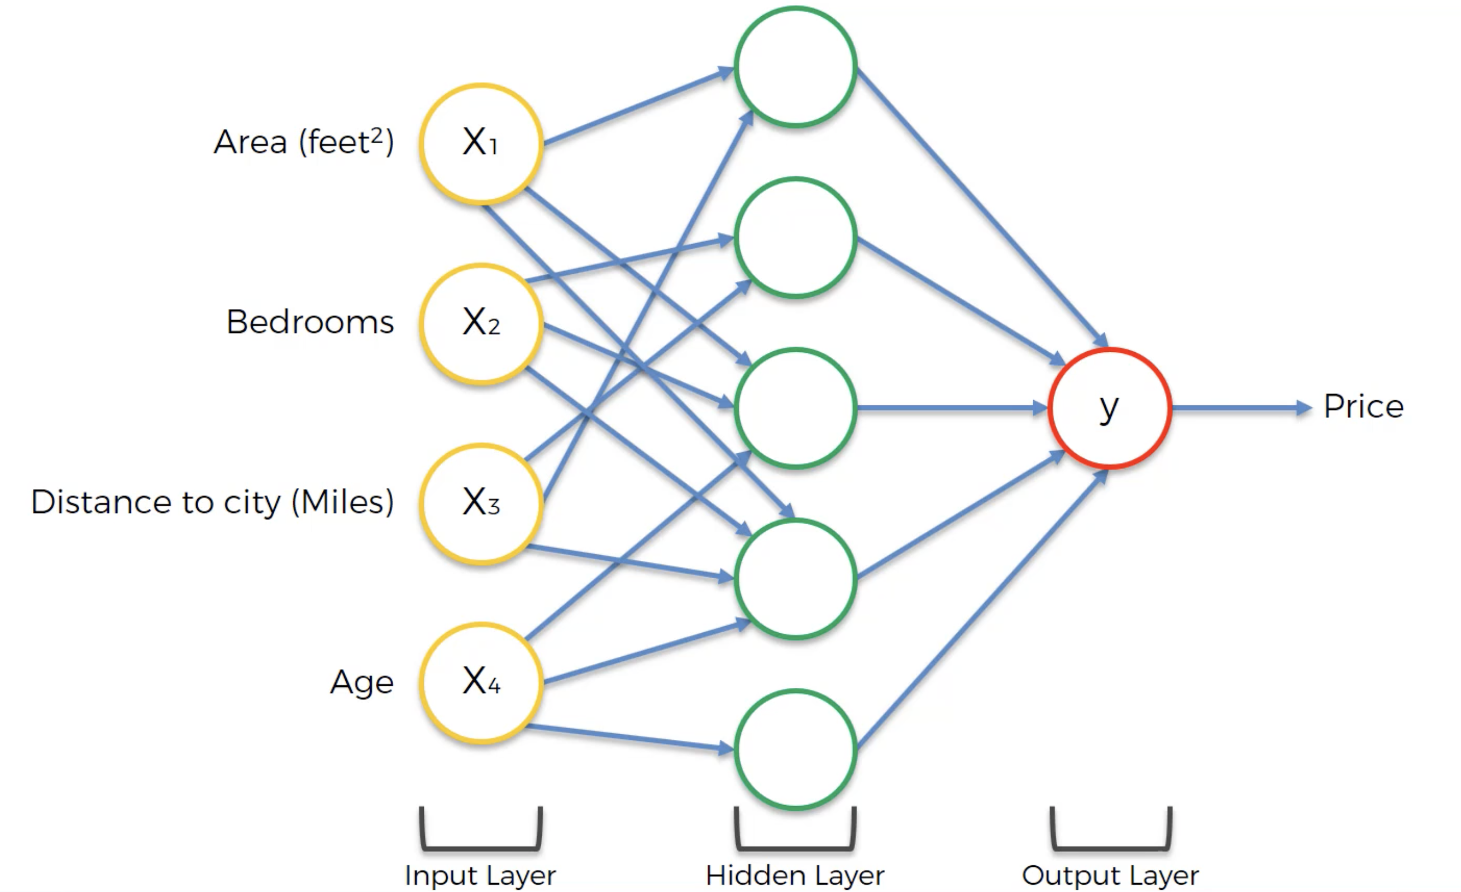
Forward Pass
Hidden layers measure higher-order interactions
$$J\left(w\right)$$
$$b$$
$${ \hat{y}=f(w}^{⊤}x+b)$$

Slide 21
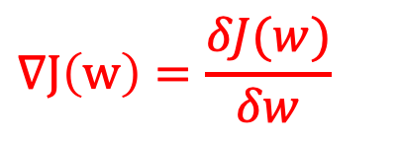
Update
How do we update with activations and hidden layers?
$$∇J\left(w\right)=\frac{δJ(w)}{δw}$$
$$b$$
$${ \hat{y}=f(w}^{⊤}x+b)$$

Slide 22
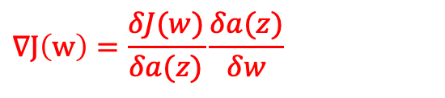
Update
How do we update with activations and hidden layers?
$$∇J\left(w\right)=\frac{δJ(w)}{δa(z)}\frac{δa(z)}{δw}$$
$$b$$
$${ \hat{y}=f(w}^{⊤}x+b)$$

Slide 23
Python
Notes:
Guidelines
Use a title slide at the beginning of your presentation. There are 9 variations of title slides to choose from.
If you will have a series of slideshows, we recommend using the same style of title slide for each presentation.
Keep your title to no more than 2 lines.
Do not change the font style or font size of the title or subtitle.

Slide 24
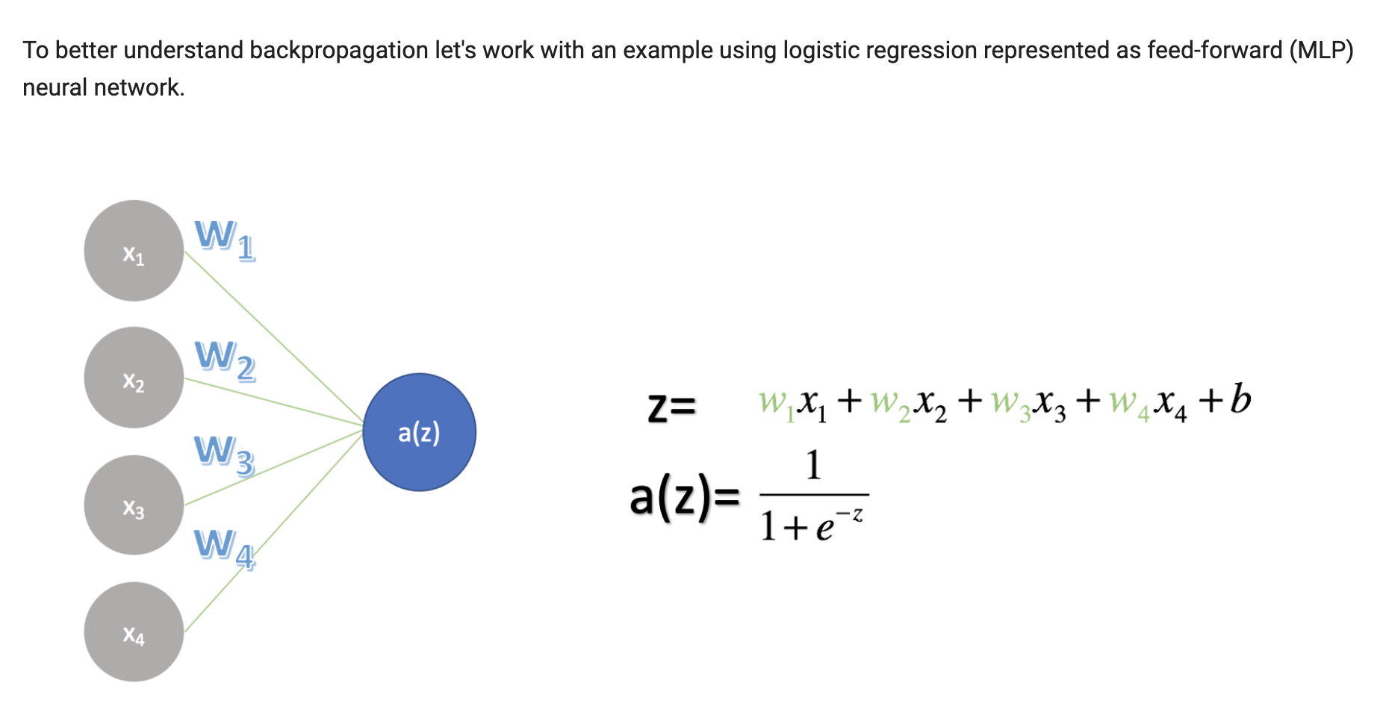
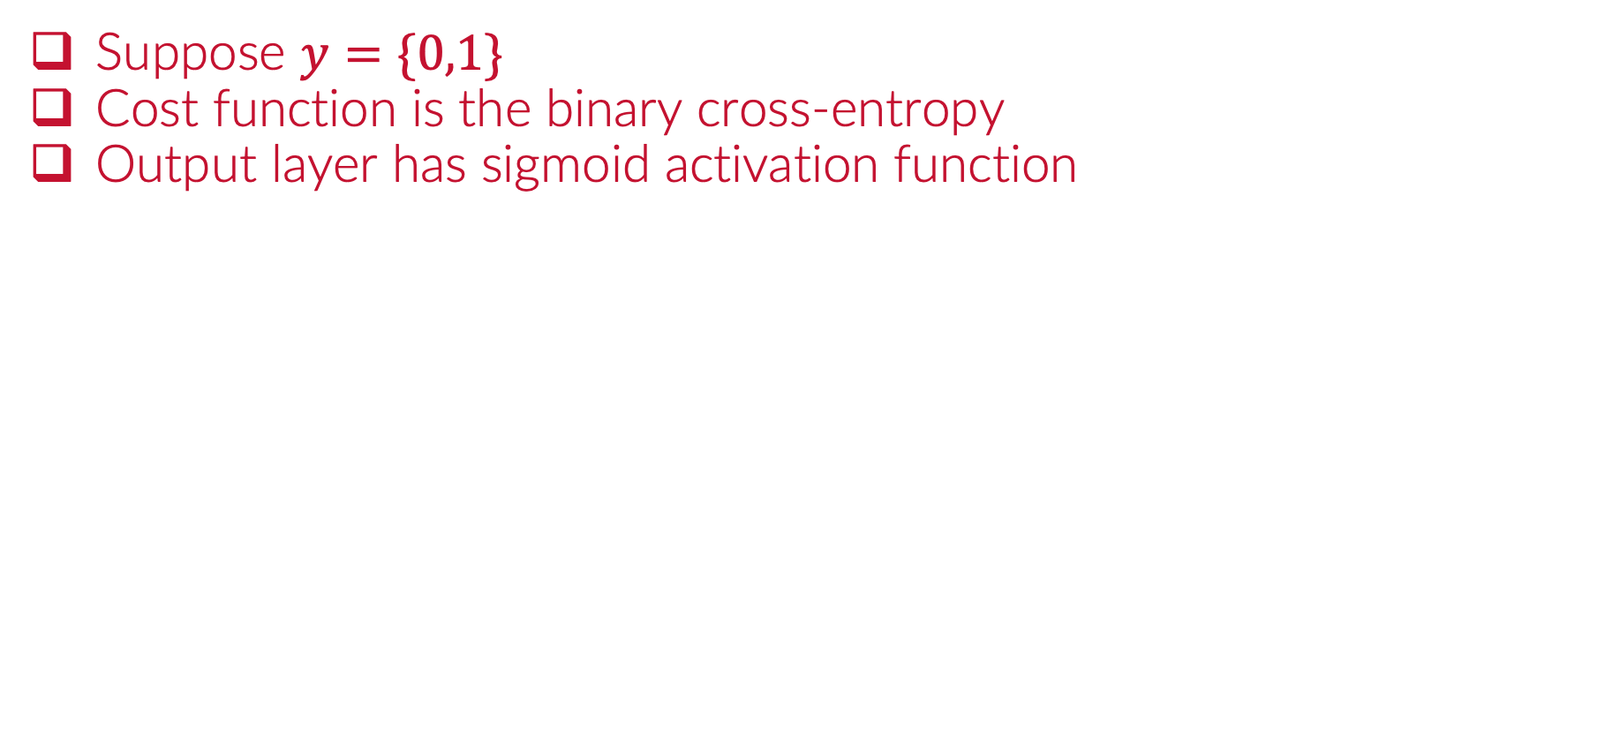
Everything is Vectorized
Suppose $y=\{0,1\}$
Cost function is the binary cross-entropy
Output layer has sigmoid activation function

Slide 25
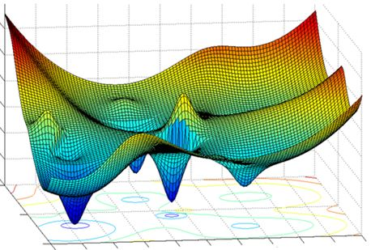
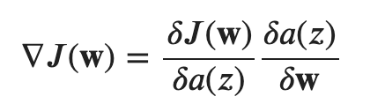
Everything is Vectorized
Suppose $y=\{0,1\}$
Cost function is the binary cross-entropy
Output layer has sigmoid activation function

Slide 26
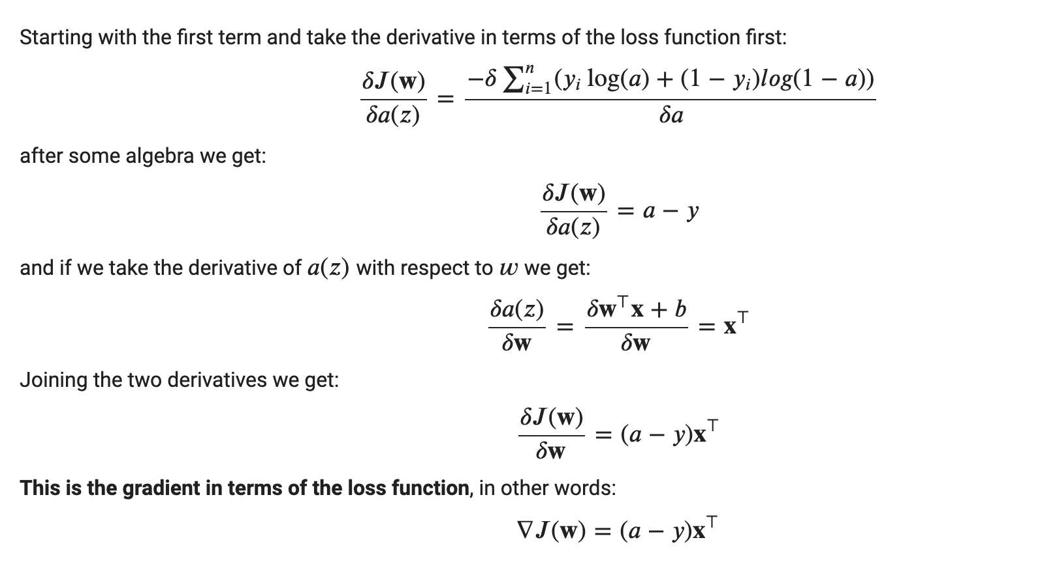
Everything is Vectorized
Suppose $y=\{0,1\}$
Cost function is the binary cross-entropy
Output layer has sigmoid activation function

Slide 27
Everything is Vectorized
Suppose $y=\{0,1\}$
Cost function is the binary cross-entropy
Output layer has sigmoid activation function

Slide 28
Everything is Vectorized
Suppose $y=\{0,1\}$
Cost function is the binary cross-entropy
Output layer has sigmoid activation function

Slide 29
Everything is Vectorized
Suppose $y=\{0,1\}$
Cost function is the binary cross-entropy
Output layer has sigmoid activation function

Slide 30
Everything is Vectorized
Suppose $y=\{0,1\}$
Cost function is the binary cross-entropy
Output layer has sigmoid activation function

Slide 31
Everything is Vectorized
Suppose $y=\{0,1\}$
Cost function is the binary cross-entropy
Output layer has sigmoid activation function
How weights are updated

Slide 32
Everything is Vectorized
Suppose $y=\{0,1\}$
Cost function is the binary cross-entropy
Output layer has sigmoid activation function
How biases are updated
All updates are done here

